Slide 1
ProTutorBD
Course Teacher:
Dr. Suman Ahmmed
Associate Professor, CSE Director, Center for Development of IT Professionals (CDIP)
Presented By:
Rayhan Al Shorif – 0122410022
Iftekharul Islam - 0122410013
F. M. Shefat Hossain Niloy-0122310011
Arnab Protim Mondal-0122320014

Slide 2

Introduction
Platform to find out reliable study assistant
Proper Training and Guidance
Request a Tutor
Find a Tutor
Nearest Tuitions
Monitoring and
Evaluation
United International University (UIU)
Page: 01

Slide 3
Motivation
Always existing demand for experienced tutor
Parents and students are worried about fraud and sources to find to tutor
Increasing internet accessibility and available online tools
Students and many varsity graduates are in quest of tuition
Comfortable and convenient for all
United International University (UIU)
Page: 02

Slide 4





Existing Products
We have selected some of the top-tier products on the market to benchmark our products.
United International University (UIU)
Page: 03

Slide 5
Features of Existing Products
Tutor Request
Hire tutor
Payment System
Request a tutor(specific requirements)
Quick Chat
Online tuition
Become tutor
Available Tuitions
Premium tutor
Tuition Post
Payment
United International University (UIU)
Page: 04

Slide 6
Features of Existing Products
Hire tutor
Hire tutor
Become tutor
Become tutor
Tuition Post / Job board
Tutor List
Today Available Tuition
Request for tutors
Available Tuitions
Payment
Quick Chat
Review & Rating
United International University (UIU)
Page: 05

Slide 7
Benchmark Products
Features |  | tutorsheba.com | bdtutors.com | caretutors.com | dhakatutors.com | deshtutor.com | Our Product
Roles | Admin
 | Tutor
 | Students
 | Guardian
Available Tuitions
Payment System
Premium Tutors Search
Affiliate Partner
Notifications System
FAQ
Contact Us
Tutor Request
Quick Chat
Online tuition
Review & Rating
About us
Default auto search & suggest tutor
Blog Post
Download Books
Suggested nearest tutors or students
Provides suggestions
United International University (UIU)
Page: 06

Slide 8
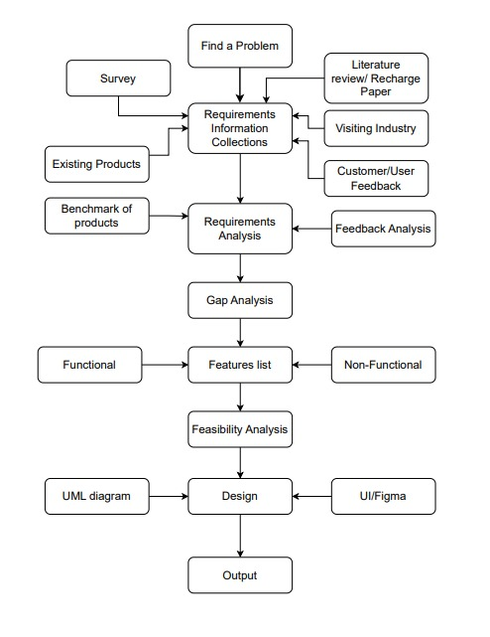
Methodology
United International University (UIU)
Page: 07

Slide 9
Features List
(Functional & Non-Functional)
Functional Requirements:
Users (teacher and student) can register, log-in to the system and update their proﬁle.
Teacher can create post by ﬁlling up the post related information and giving a certain amount for creating a post (if he/she has no free posts. After creating their proﬁle tutor will get 3/n-numbers of free posts.)
Tutor can search for tuition and send request to a corresponding tutor searching post(posted by any student)
Tutor and student both can give ratings and reviews to each others
Tutor and student both will be able to download books
Tutor and student both will be able to create, read, edit, delete blogs
Admin can delete/block any user (student and Teacher) if the admin gets multiple complaints against the user
Admin will be able to upload, download and delete books
A searching mechanism will be provided by the system to get the post
The system will be accessible to online users
United International University (UIU)
Page: 08

Slide 10
Features List
(Functional & Non-Functional)
Non - Functional Requirements:
Users’ privacy should be protected
The system should be workable on diﬀerent cross-platform web browsers like (e.g. Chrome, Safari, Mozilla, Opera, Edge)
The system should have high availability
The system should be easy to learn by both sophisticated and novice users
The system should be user friendly so that both sophisticated and inexperienced users can learn to use it at ease
The system should have a maximum of 3 clicks to reach any content
The system should have a single login to access all content
The system should have a consistent user interface(UI)
The system should have a UI which is intuitive (the behavior of the system is according to the intuition of a standard end user)
The system should have a standard graphical user interface that allows for the on-line data entry, editing, and deleting of data with much ease
United International University (UIU)
Page: 09

Slide 11
Research paper Study
The issue of private tuition: an analysis of the practice in mauritius and selected south-east asian
countries
What they Found:
Prevalence: Private tuition is widespread at both primary and secondary levels across Mauritius and Southeast Asian countries.
Motivations: Competitive exams, pressure for success, and perceived shortcomings in formal education drive demand.
Financial Burden: Significant cost burden on families, potentially widening social inequalities.
Mixed Effects: Some students benefit, others experience stress and decreased motivation.
Teacher Involvement: Raises ethical concerns, potential conflicts of interest, and exploitation of students.
Ineffective teaching-learning processes , Insufficient Regular Class Instruction, Students seek private tuition for better understanding and individual attention.
Teachers, often demotivated in regular classes, become more engaged in tuition as they work for themselves.
Class Size Challenges: Large class sizes, Financial constraints, inadequate infrastructure, and a shortage of qualified teachers
Students opt for private tuition due to peer pressure and competition
Other findings:
Limited data availability on specific impacts and student outcomes.
Difficulty isolating true effects of private tuition from other factors.
Generalization of findings across diverse countries and contexts.
United International University (UIU)
Page: 10

Slide 12
Research paper Study
The more, the better? Intensity of involvement in private tuition and examination performance
What they Found:
There is no significant advantage to taking private tuition, even for students who took a lot of it.
This suggests that other factors, such as a student's natural ability and attitude towards learning, may be more important for exam success than private tuition.
Limitations:
The study was conducted in Ireland, so the results may not be generalizable to other countries.
The study relied on self-reported data, which can be subject to bias.
The study did not control for all possible factors that could affect exam performance
United International University (UIU)
Page: 11

Slide 13
Research paper Study
The Demand for Shadow Education: Socioeconomic Determinants and Implications
What they Found:
Kids who got extra tutoring did tend to score better in school.
Extra tutoring can be expensive, and it can make it harder for poorer families to keep up.
Some kids get a big advantage because their families can afford extra help.
If tutorial centers run alongside schools long-term, good teachers might leave schools, lowering education quality. This could make tutoring even more essential.
Maybe schools need to get better so that all kids get the help they need, without their families having to pay extra.
Limitations:
More research is needed considering factors like student-teacher ratio and high-stakes test levels in various schools.
United International University (UIU)
Page: 12

Slide 14
Research paper Study
The Expansion and Roles of Private Tutoring in India: From Supplementation to
Supplantation
What they Found:
Private tutoring, also known as "shadow education", is HUGE in India. Many students get extra help outside of school from private tutors.
It used to be seen as "supplementary," just filling in gaps from regular school. But now, it's more like "supplantation," meaning it's almost like a whole different school system happening alongside the official one.
This shift has some big upsides and downsides. On the plus side, some say it helps students do better in exams and get into competitive colleges. But on the other side, it creates pressure, adds financial strain on families, and can widen the gap between rich and poor students.
Limitations:
The authors studied tutoring in Maharashtra, India. They found that students rely heavily on tutors, especially for key subjects like math and science. Tutors often focus on exam preparation and specific strategies, rather than broader learning..
United International University (UIU)
Page: 13

Slide 15
Research paper Study
The impact of shadow education on student academic achievement: Why the research
is inconclusive and what can be done about it
What they Found:
Positive impacts on some students and contexts.
Also no significant difference in academic performance between students who participated in shadow education and those who didn't.
potentially negative consequences like increased stress and increases educational inequality
Limitations:
Research methods face challenges in data collection and analysis, limiting the ability to isolate the true impact of shadow education.
Difficulty in accounting for individual student characteristics and motivations, as well as the quality of tutors, which can significantly impact outcomes.
United International University (UIU)
Page: 14

Slide 16
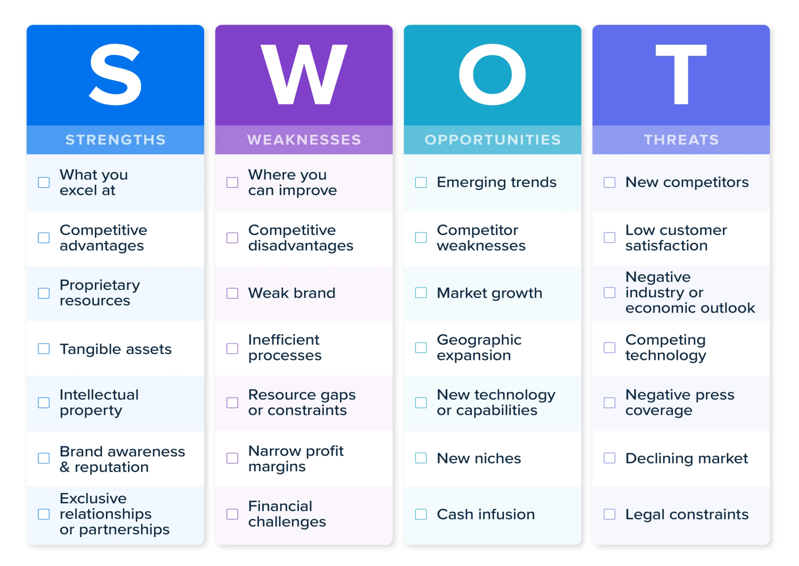
Feasibility Analysis
United International University (UIU)
Page: 15

Slide 17
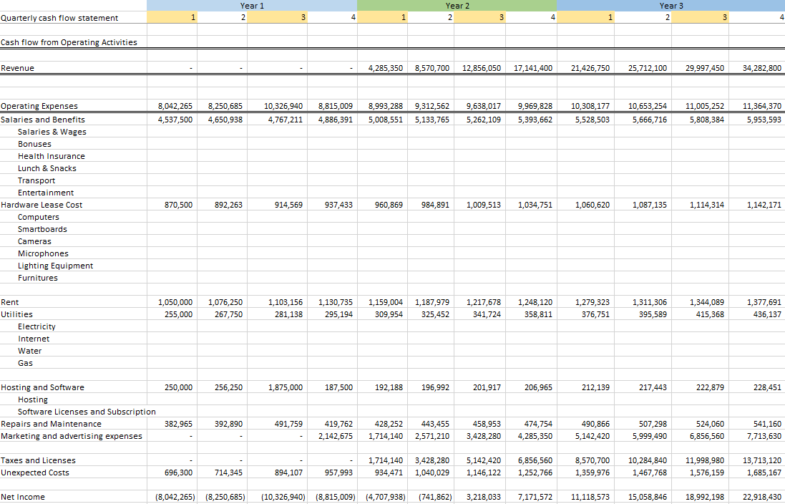
Cost Model and Cost Flow Diagram
United International University (UIU)
Page: 16

Slide 18
Novelty
ProTutorBD's primary innovation is that it helps us find automated location-based tutors with streamlined, learning, seamlessly combining modern technology with human expertise to create a rich learning experience tailored to each student's needs.
United International University (UIU)
Page: 17

Slide 19
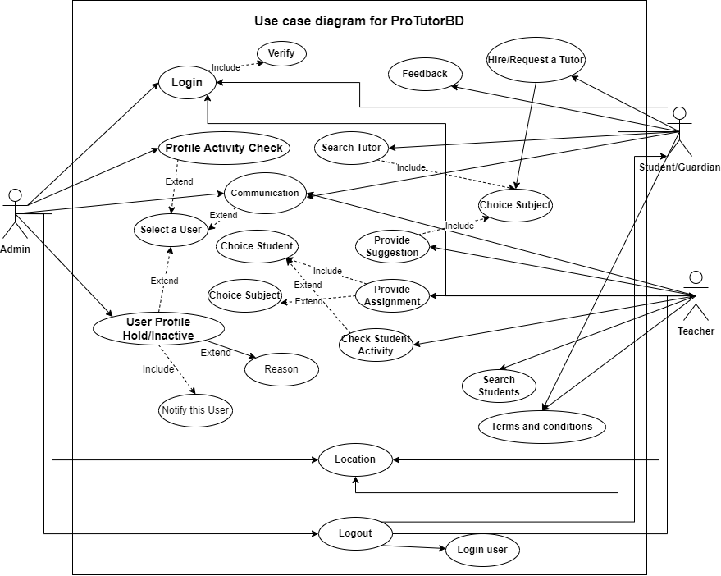
UML Design
Use case diagram.
United International University (UIU)
Page: 18

Slide 20
UML Design (Cont.)
Search Tutor:
Use Case Number and Name: | UC001 – Search Tutor
Primary Actor: | Students or Guardians
Interests & Stakeholders: | Students and guardians are browsing and searching for tutors from our platform.
Prerequisites: | The student or guardian is must be logged in.
Success Scenario: | Student or guardian search tutor by typing in search box. Auto suggested tutor list in dropdown. Click on tutor name and search him/her.
Alternative Scenario: | In step 1 after typing something then it will not match from our database and show “no records” In step 2 type something and click on it. If this tutor are not available for this course then show “Tutor is not available right now”
Post condition: | After typing the tutor name for searching then it will go to backend and search this tutor from our database. Then it will redirect new page with this tutor related information and show it.
United International University (UIU)
Page: 19

Slide 21
UML Design (Cont.)
Provide Suggestions:
Use Case Number and Name: | UC002 – Suggestion Provide
Primary Actor: | Teacher
Interests & Stakeholders: | A Teacher are browsing and sharing subject related suggestion for his/her student from our platform.
Prerequisites: | The teacher is must be logged in and selected subject.
Success Scenario: | Teacher choice the subject Uploaded pdf as suggestion
Alternative Scenario: | In step 1 after choice this subject, if this subject has not enroll of any student then it will show “No enrolled student” In step 2 when upload a pdf , if the pdf size is larger then 10mb it will show “Large File Uploaded”
Post condition: | After successfully uploaded file it will show suggest list.
United International University (UIU)
Page: 20

Slide 22
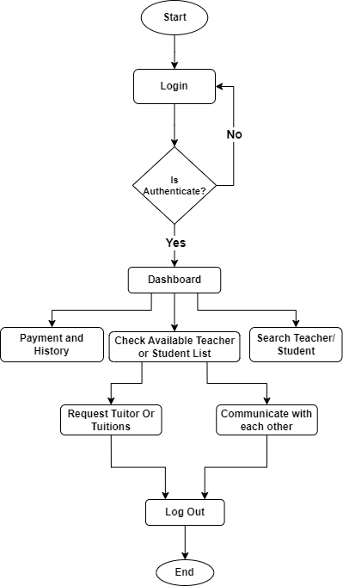
UML Design (Cont.)
Activity Diagram:
United International University (UIU)
Page: 21

Slide 23
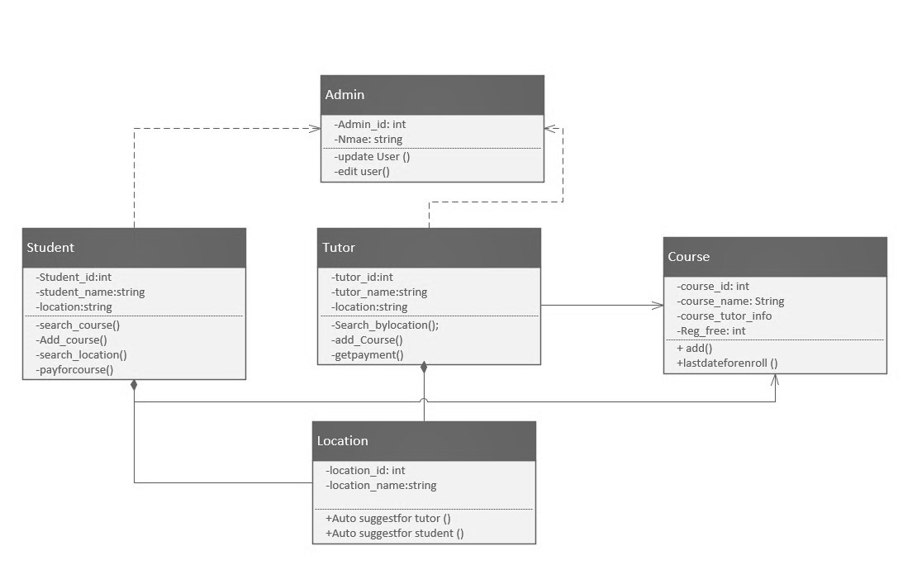
UML Design (Cont.)
State diagram:
United International University (UIU)
Page: 22

Slide 24
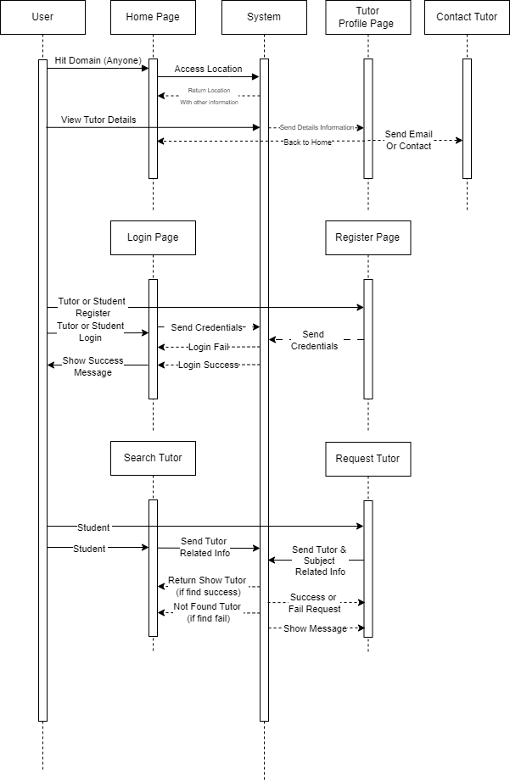
UML Design (Cont.)
Sequence Diagram:
United International University (UIU)
Page: 23

Slide 25
Class Name
public function Course{
registerCourse();
courseFee()
}
public function Student {
registerCourse();
payFee();
searchLocation();
}
Public function Location (){
suggestTutor();
access();
}
public function Admin{
updateuser();
verifyUser()
}
public function Student{
searchTutor();
payCourse()
}
public function Tutor{
search_Tuiton();
chatWithStudent()
}
United International University (UIU)
Page: 24

Slide 26
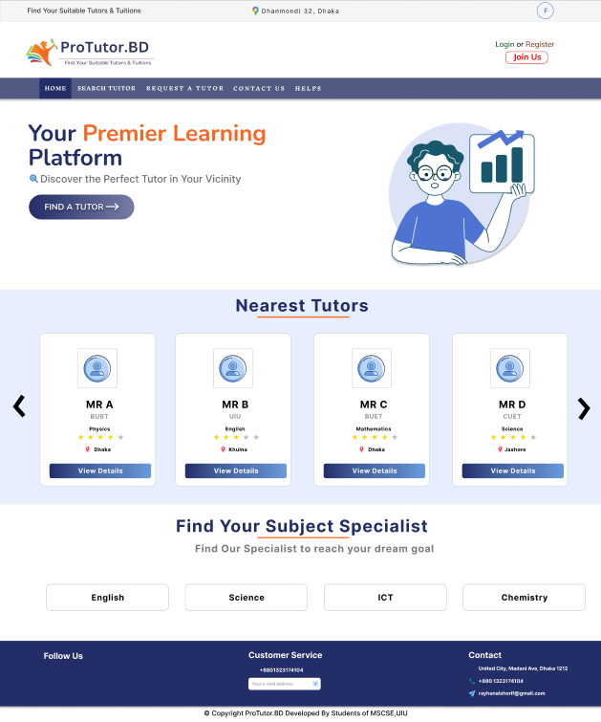
UI Design (Figma)
Fig: Home Page
United International University (UIU)
Page: 25

Slide 27
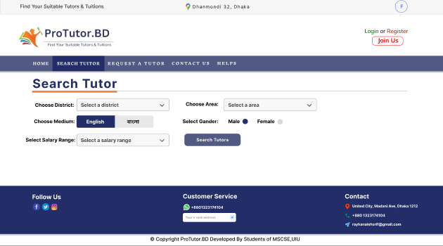
UI Design (Figma)
Fig: Search Tutor
United International University (UIU)
Page: 26

Slide 28
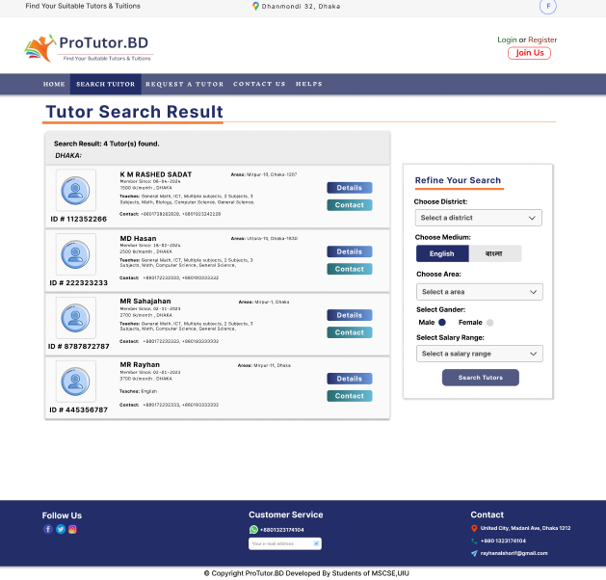
UI Design (Figma)
Fig: Search Tutor Result
United International University (UIU)
Page: 27

Slide 29
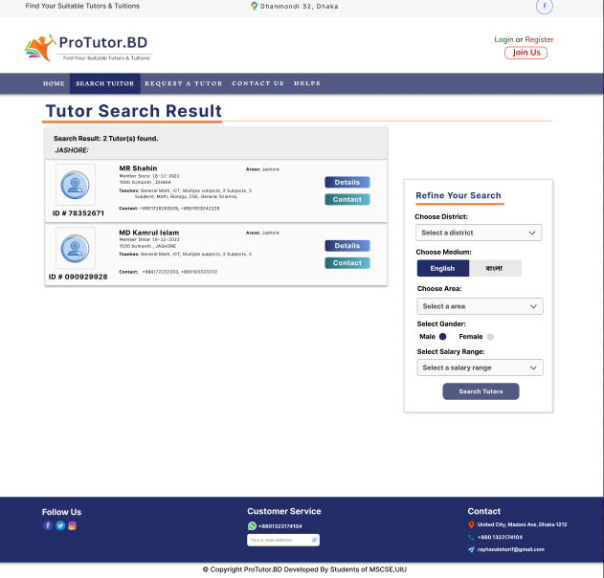
UI Design (Figma)
Fig: Search Tutor Result_1
United International University (UIU)
Page: 28

Slide 30
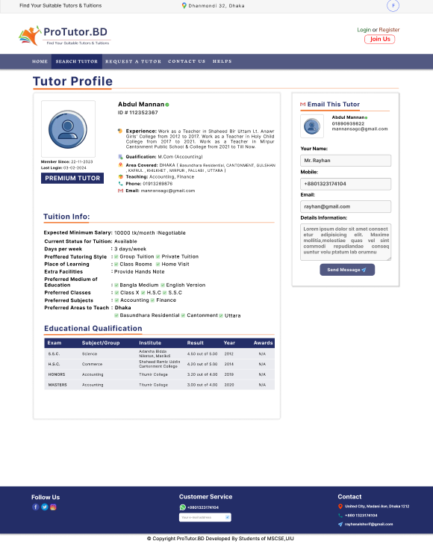
UI Design (Figma)
Fig: Tutor Profile
United International University (UIU)
Page: 29

Slide 31
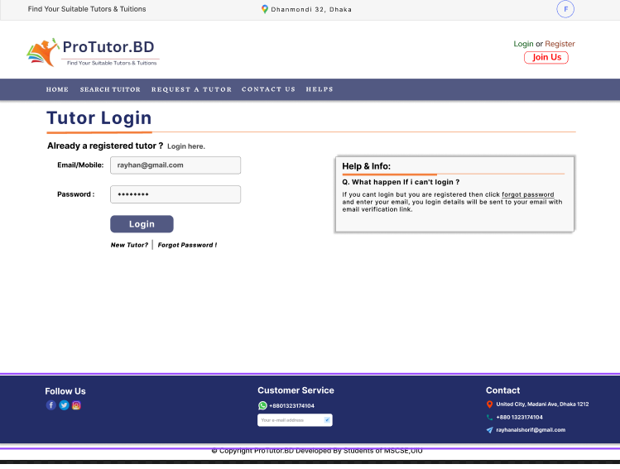
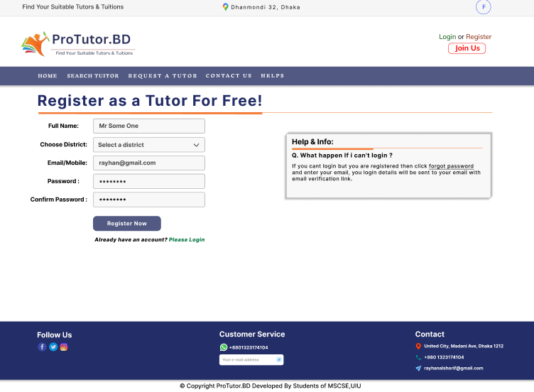
UI Design (Figma)
Fig: Tutor Login
Fig: Tutor Register
United International University (UIU)
Page: 30

Slide 32
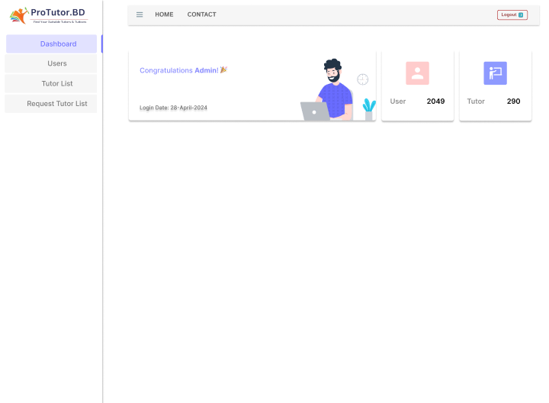
UI Design (Figma)
Fig: Admin Dashboard
United International University (UIU)
Page: 31

Slide 33
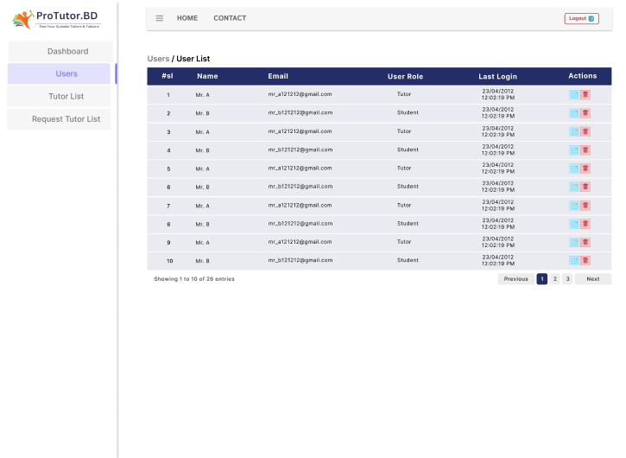
UI Design (Figma)
Fig: User list
United International University (UIU)
Page: 32

Slide 34
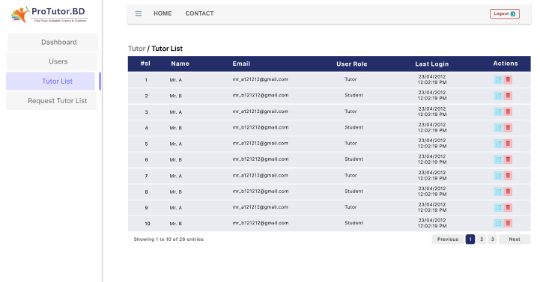
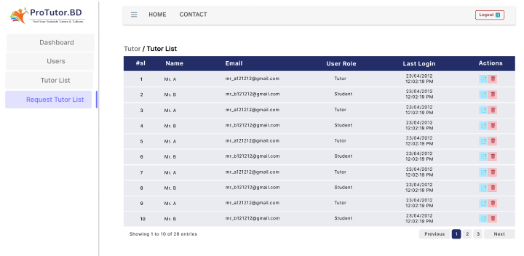
UI Design (Figma)
Fig: Tutor list
Fig: Request Tutor list
Fig Link:
https://www.figma.com/proto/8ygJCRXqf5qbWQzErEUyiI/ProTutor.BD?type=design
&node-id=295-561&t=Ay6sOf14krKCsJwK-0&scaling=min-zoom&page-id=0%3A1
United International University (UIU)
Page: 33

Slide 35
References
[1]_https://www.tandfonline.com/doi/full/10.1080/13803610802246395
[2]_https://www.researchgate.net/publication/349213058_The_Demand_for_Shadow_Education_Socioeconomic_Determinants_and_Implications
United International University (UIU)
Page: 34

Slide 36
Any Questions?

Slide 37
THANK YOU
Thanks for your valuable time.

